Slide 1
Improving Sweetpotato Packing Line Ergonomics
Lesley Strawderman
Brooke Cannon
Liza Copeland
Mississippi Sweetpotato Winter Production Meeting
February 13, 2014
Pittsboro, MS

Slide 2
What is Ergonomics?
Fitting the job to the person
Considers human abilities, tools, and work requirements in job design
Goals of ergonomics: health, safety, and productivity

Slide 3
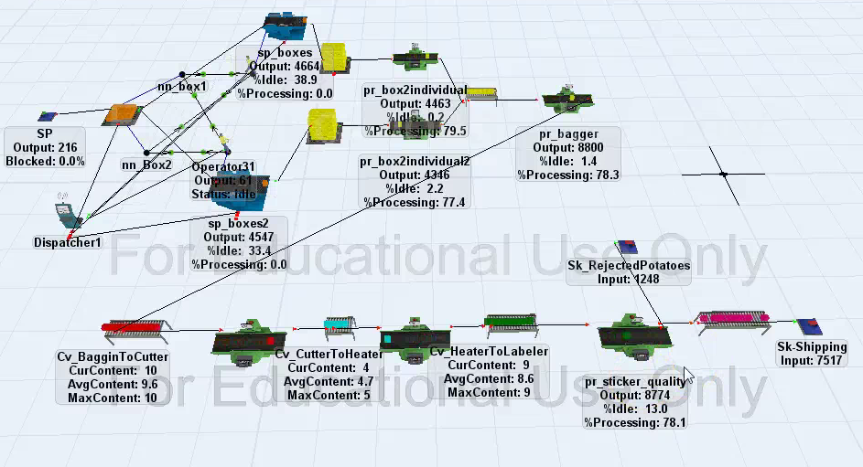
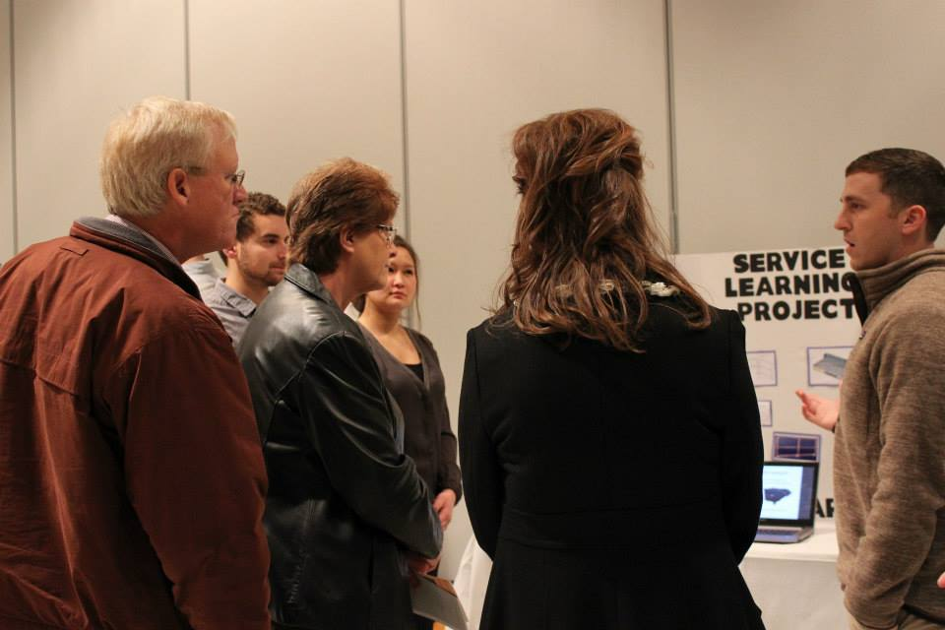
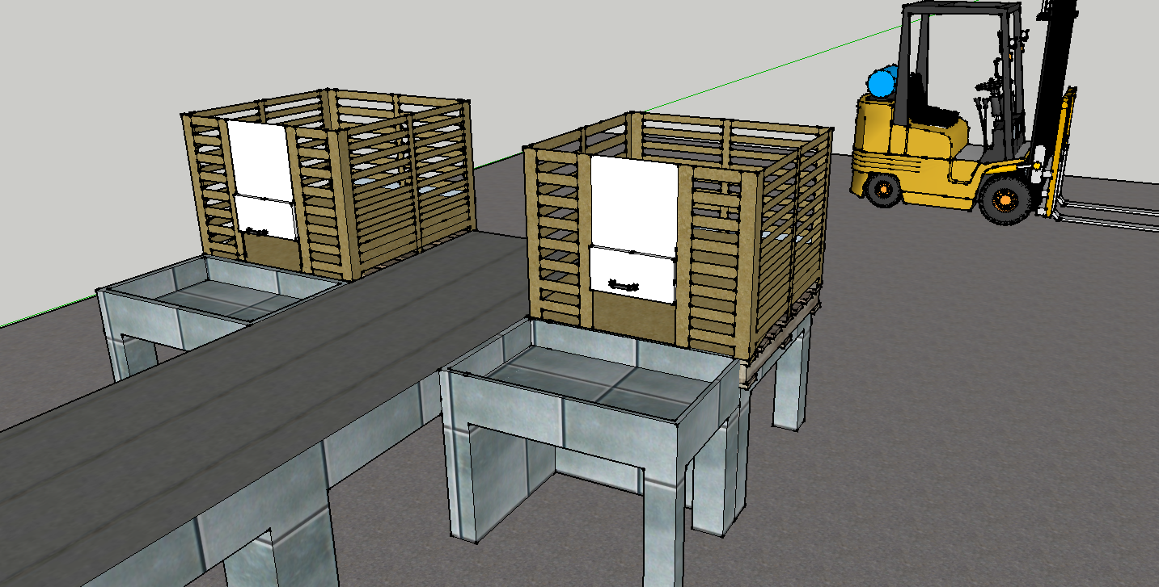
Service-Learning Project
Mississippi State University
Fall 2013
IE 3123, Industrial Ergonomics
44 junior/senior industrial engineering students
Operations and ergonomics improvements
Partner: N&W Farms, Vardaman

Slide 4
Top Ergonomics Opportunities
Lifting full boxes
Seated working posture
Standing worker fatigue
Minimize reach
Working height
Notes:
for Sweetpotato Packing Lines

Slide 5
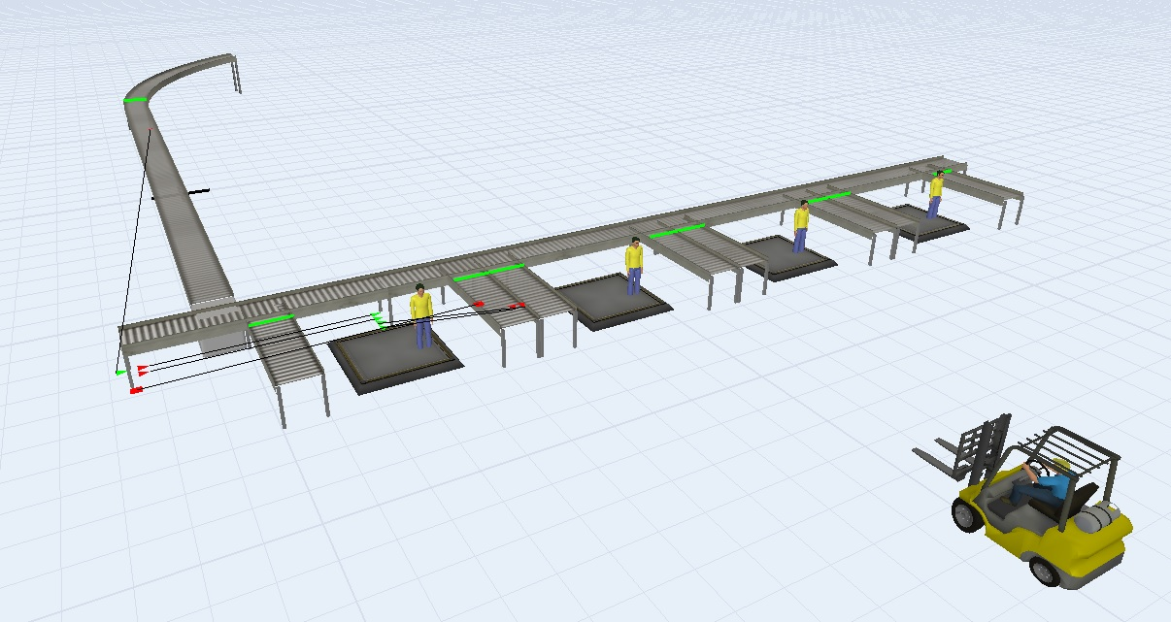
1. Lifting Full Boxes
Problem: Lifting and carrying heavy boxes puts workers at risk for back and shoulder injuries.
Solution: Reduce weight of load (infeasible), reduce travel distance, assisted lifts, keep lifts close to body

Slide 6
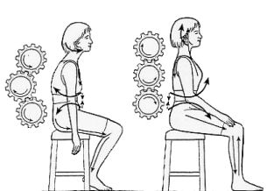
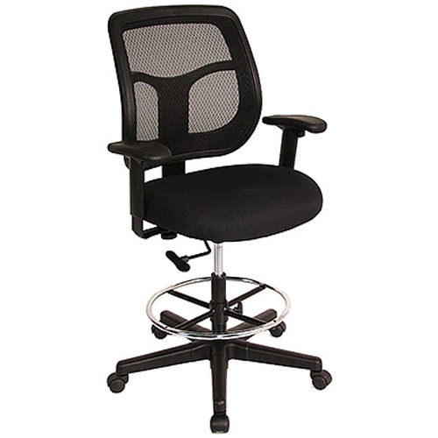
2. Seated Working Posture
Problem: Poor posture while seated can lead to back, neck, and shoulder strain, which contributes to WMSDs and cumulative injuries.
Solution: Provide all workers with appropriate seating. This includes back and arm rests, adjustable height, and foot rests.

Slide 7
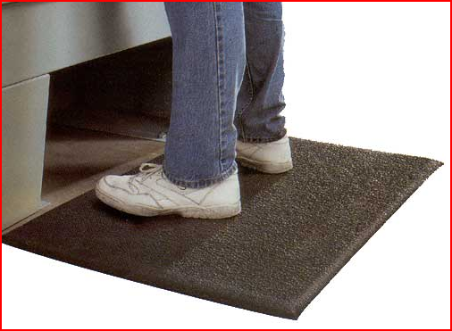
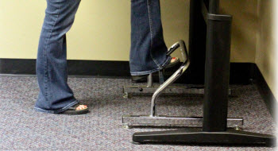
3. Standing Working Fatigue
Problem: Poor standing surfaces (e.g. concrete, metal) increases pressure on lower extremities, leading to increased fatigue and lower productivity.
Solution: Use of anti-fatigue flooring, such as rubberized mats. All mats should have beveled edges and no-slip surface. Provide foot rests for shifting posture during work.

Slide 8
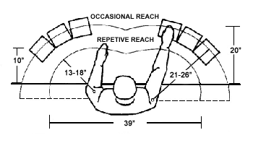
4. Minimize Reach
Problem: Arm extensions can lead to shoulder injuries, back pain, and posture imbalance.
Solution: Relocate work within preferred reach zone. Workstations should be designed so employees can keep elbows at their side, except for occasional reaches.

Slide 9
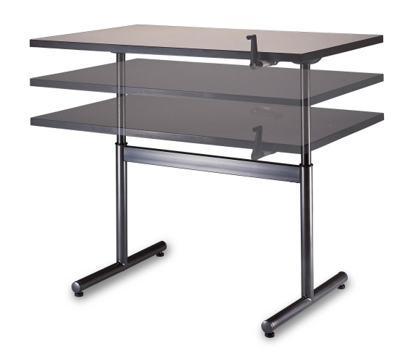
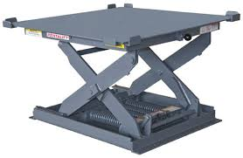
5. Working Height
Problem: Work height not appropriate for all workers based on seated or standing stature. This leads to bending or straining, which could lead to cumulative injuries.
Solution: Adjust all work heights to 2” below worker’s elbow. This can be done by adjusting work surface or sit/stand surface. Adjustability is key for shared workstations.

Slide 10
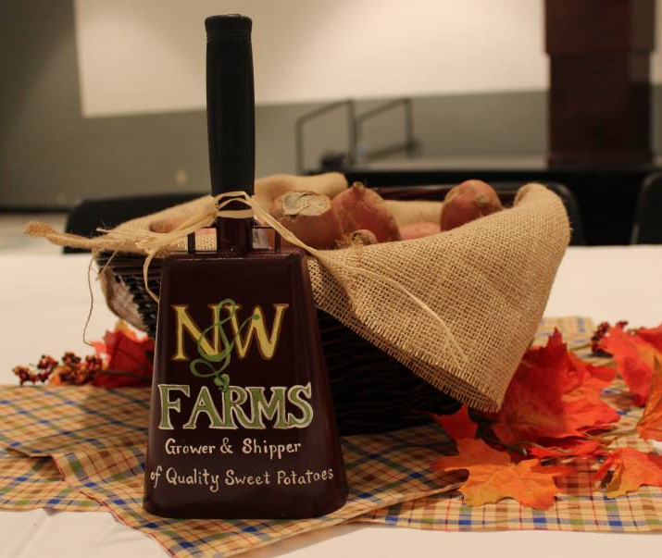
Questions?
Lesley Strawderman, PhD, PE
662-325-7214; strawderman@ise.msstate.edu

